Slide 1
LWTech Open Textbook / Course Materials Development Funding Info Session
with Greg Bem and Katherine Kelley, Faculty Librarians
Unless otherwise noted, this PowerPoint by Greg Bem and Katherine Kelley is openly licensed under CC BY 4.0

Slide 2
Purpose
Provide funding for instructors to develop course materials
Encourage faculty to join the Open Educational Resources (OER) movement

Slide 3
What is OER?
Learning materials that are openly licensed for public use or are not copyrighted.
Image by manfredsteger is openly licensed through Pixabay​

Slide 4
Open Licenses/Creative Commons Licenses
Most
Open
Attribution
CC BY
Attribution-ShareAlike
CC BY-SA
Attribution-NoDerivs
CC BY-ND
Attribution-NonCommercial
CC BY-NC
Attribution-NonCommercial-ShareAlike
CC BY-NC-SA
Least
Open
Attribution-NonCommercial-NoDerivs
CC BY-NC-ND
Logos by Creative Commons are used here in compliance with CC policies

Slide 5
Why OER?
Students:
Save money
Have materials first day of class
Faculty can customize:
Materials can represent diverse perspectives
Materials can be made accessible to people of all abilities
Online versions are updated
Improve global education
Image by geralt is openly licensed through Pixabay​

Slide 6
Funding is available to develop OER!
Thank you to grant funding facilitated by the Office of Instruction and Vicki Chew.

Slide 7
OER Funding Program History
Winter 2022: Securing of Funding and Start of Year 1
Spring 2022: Year 1 Projects
Summer 2022: Launch of Year 2
Read more in the OER Funding Year 1 Report!

Slide 8
Project Examples

Slide 9
David Fox – Common American English Pronunciation Patterns (ELL Textbook)
https://openwa.pressbooks.pub/commonamericanenglishpronunciationpatterns

Slide 10
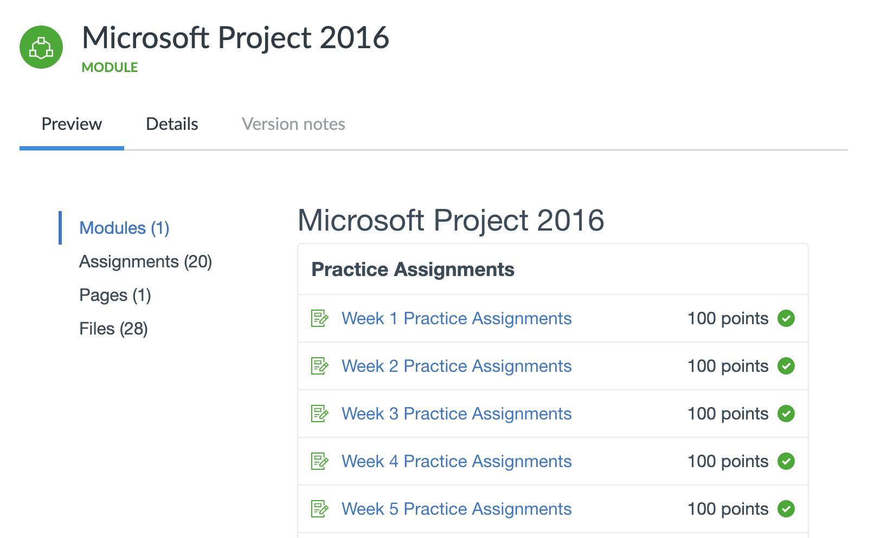
Letty Barnes – Microsoft Project 2016 Canvas Module (BTE)
https://lor.instructure.com/resources/5a236b89d85d4b23a49c8e0652d03936

Slide 11
Cathy Zupke – WAMAP.org Homework Questions (ENGR)
Cathy added questions to WAMAP.org database shared with all of WA, and BC to Oregon, open to faculty and free to students

Slide 12
Lindsey Smith – The Truth about "Fake News"? (POLS)
https://lor.instructure.com/resources/adba1680cfa1415088340eecefcd5ce4

Slide 13
Priyamvada Singh – Mechatronics PPTs (ELCT)
https://www.oercommons.org/courses/lecture-ppts-for-the-course_mechatronics

Slide 14
Want to get involved?

Slide 15
Compensation
Awards based on the scope of project
Examples:
$350 (estimated minimum of 10 hours)
$700 (estimated minimum of 20 hours)
Stipend paid upon completion of requirements

Slide 16
Requirements for Completion
OER 101 training
Create/find/adapt resources
Meet with Librarian mid-project
Openly license your work
Share your work with the world
Final meeting with Librarian
Use the resources in your teaching

Slide 17
Timeline
Rolling applications all year, as long as funding allows
Final deadline to apply is April 14, 2023
Final deadline to complete is beginning of June 6-10, 2023

Slide 18
Additional Support Opportunities
Peer-review of materials created
Digital accessibility training
Instructional design consultation
OER Canvas course
Librarian research assistance

Slide 19
Fill out an application now!

Slide 20
FAQ: Why should I openly license my work vs. traditional publishing?

Slide 21
FAQ: Can I use all rights reserved materials? How does Fair Use work with OER?

Slide 22
FAQ: How could I possibly write a textbook in 20 hours?

Slide 23
FAQ: What open license should I use?

Slide 24
FAQ: What format should I use for my OER?

Slide 25
Contact:
Katherine.Kelley@lwtech.edu
Virtual meetings – every weekday
In-person meetings –Tuesdays & Thursdays 9:00-4:00
Greg.Bem@lwtech.edu
Virtual meetings – every weekday
In-person meetings –Mondays, Tuesdays, & Wednesdays 8:30-4:30
Image by Adam Solomon is openly licensed via Unsplash​​

